Slide 1

Uncovering Marketing Trends: A Statistical Analysis of Competitive Strategies in Online Stores Using PriceSpy Database
Binara Siriwardhana
Notes:
topic

Slide 2
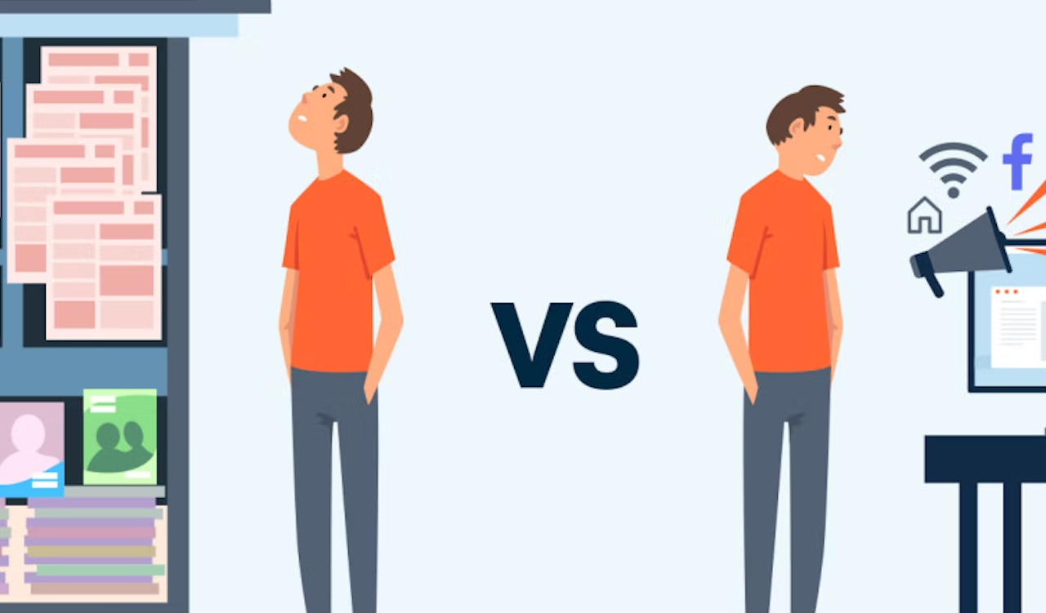
Introduction
Online Marketing has a large impact on traditional marketing.
Customers are sensitive to price changes, and they compare prices from multiple Stores.
Internet shoppers can do this within a minute and at zero cost.
Thus, online pricing is different from traditional pricing.
Notes:
In this century more popular to online marketing it large impact of traditional marketing
people are looking for low-cost product and try to compare prices between stores

Slide 3

Objective
The objectives of this study are,
“to compare the prices between selected stores and uncover trends and possible strategies used. More specifically, they can be specified as follows:
Price comparison of the mobile speaker and cellphone products between stores 1260 and 3303
Identifying strategies by comparing price trends against adjusted CPI”

Slide 4
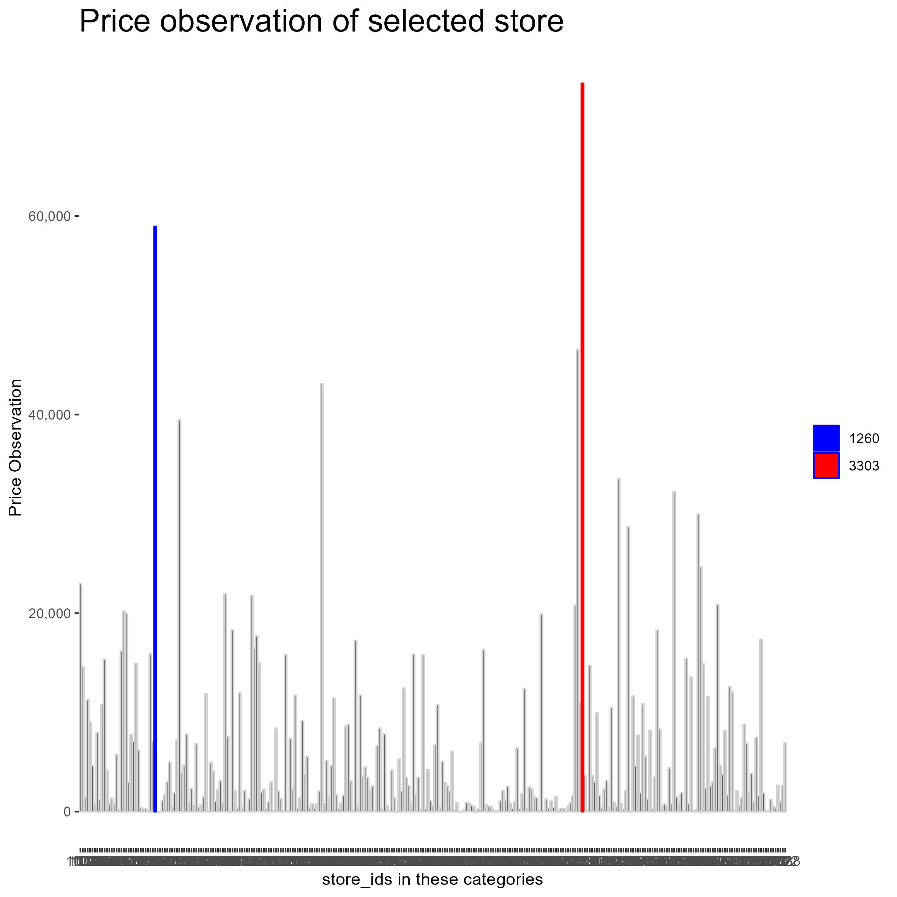
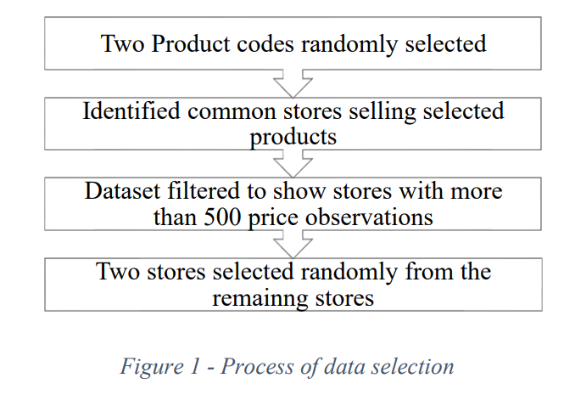
Methods
Analysis the Price Observation
Data Chosen Method
Selected two Stores are 1260 and 3303
I got the following level price observations

Slide 5
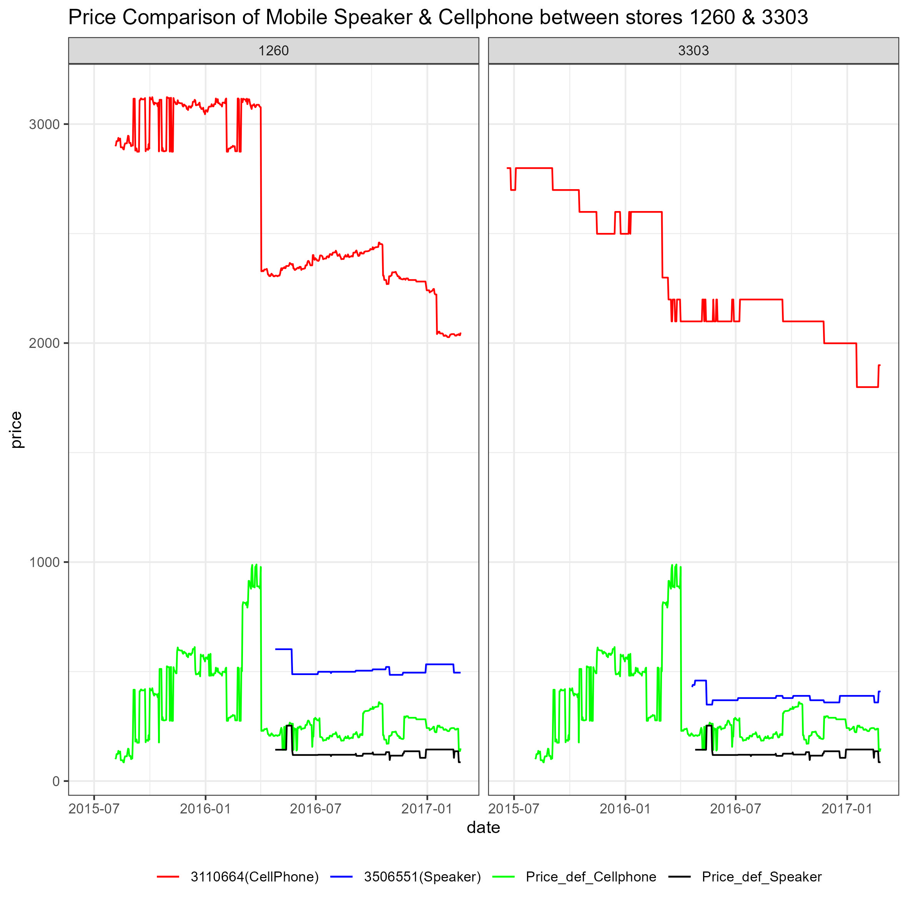
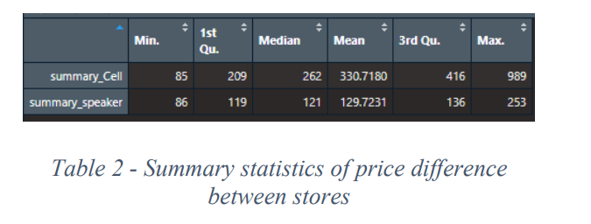
Result And Discussion
Price Comparison Between two stores
It shows a similar downtrend in both stores’ prices of Cellphone product
Store 1260 continuously sold both product at a higher price than store 3303
Store 1260 launched cellphone products a couple of weeks later than 3303, but at a higher price
The price drop between 2016 Jan and July 2016 does not seem like a strategic move
Table 2 shows summary statistics of price difference between the two stores
Notes:
Speaker price The price has not decreased much

Slide 6
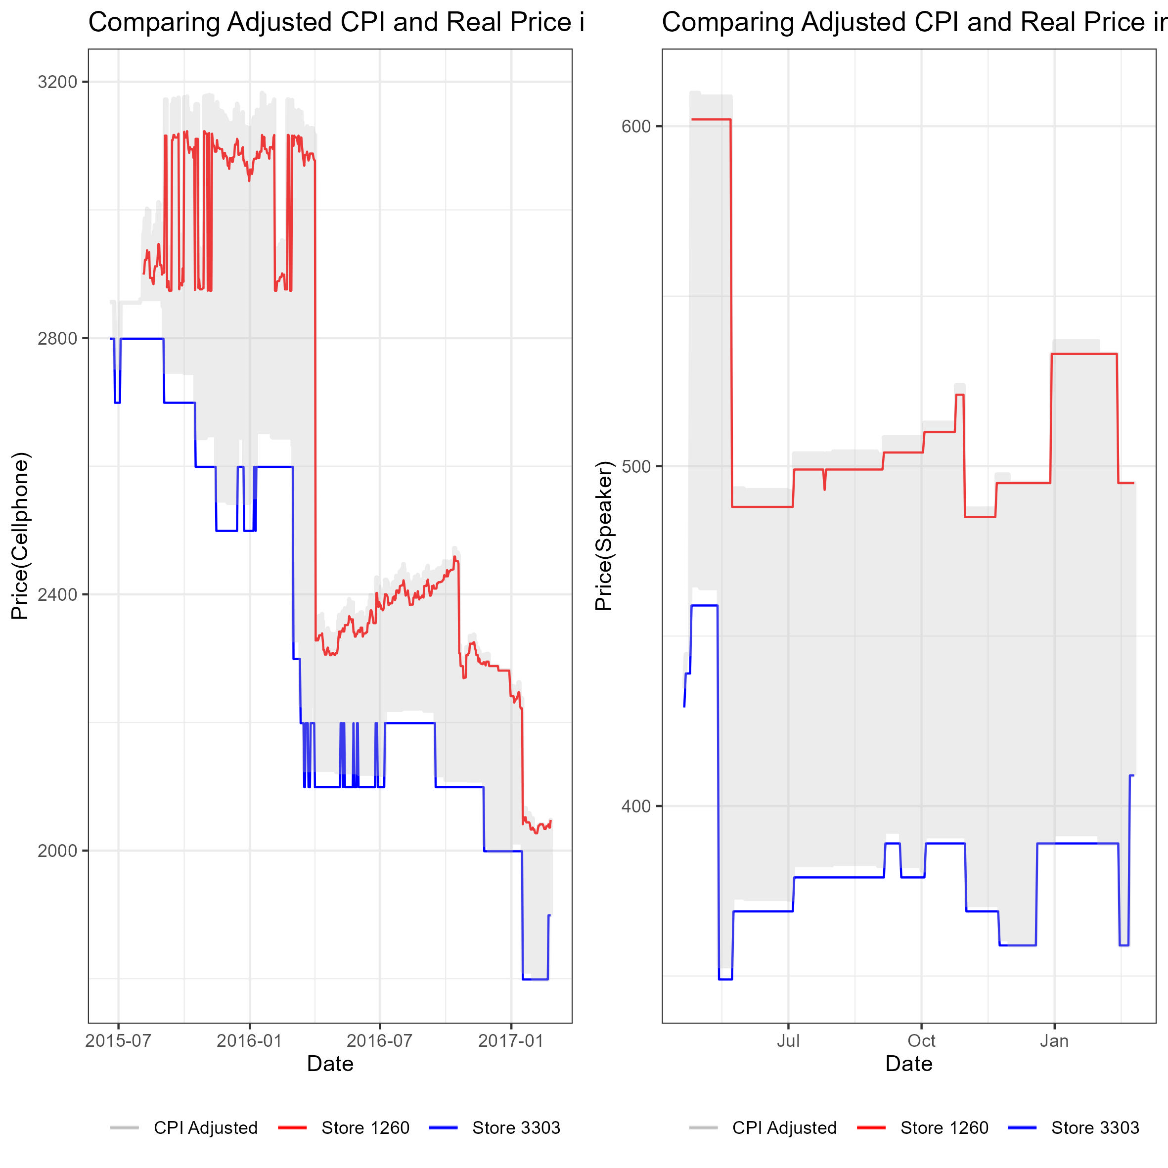
Result And Discussion
Identifying strategies using price trends against adjusted CPI
Store 3303 as used the strategic method to place their price below the CPI
Store 1260’s strategy has been placing their price close to the upper limit of CPI

Slide 7
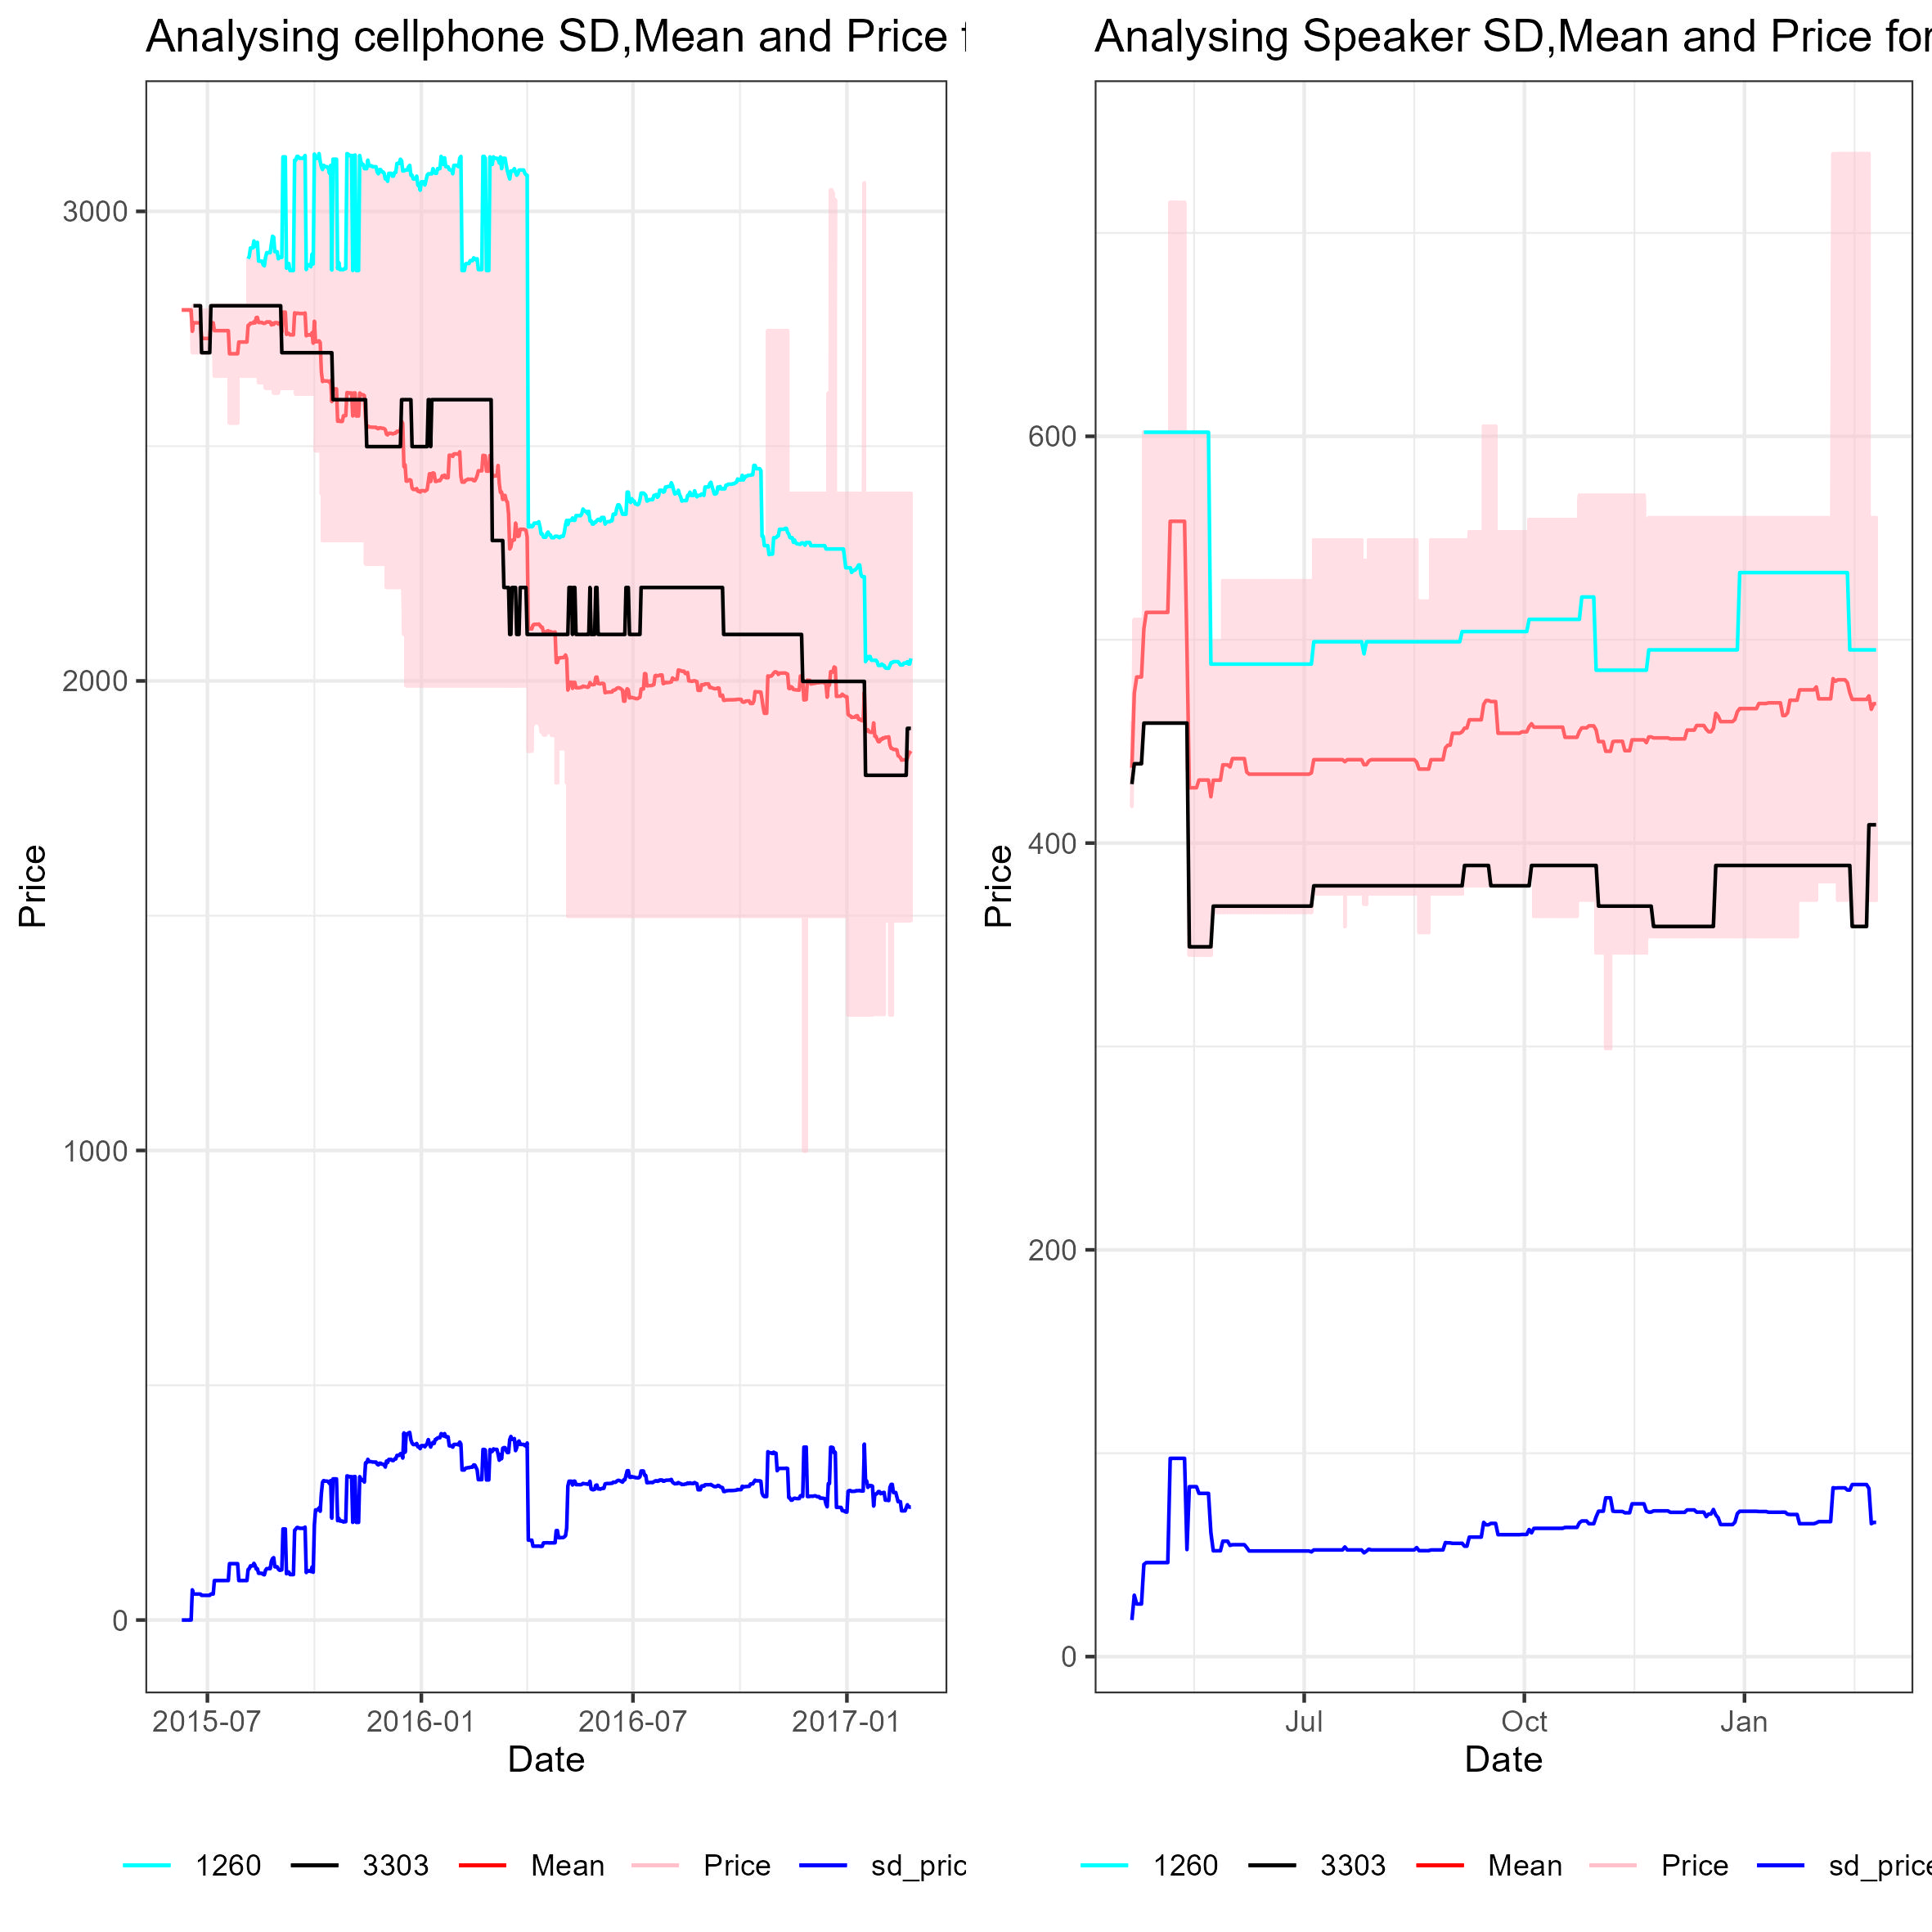
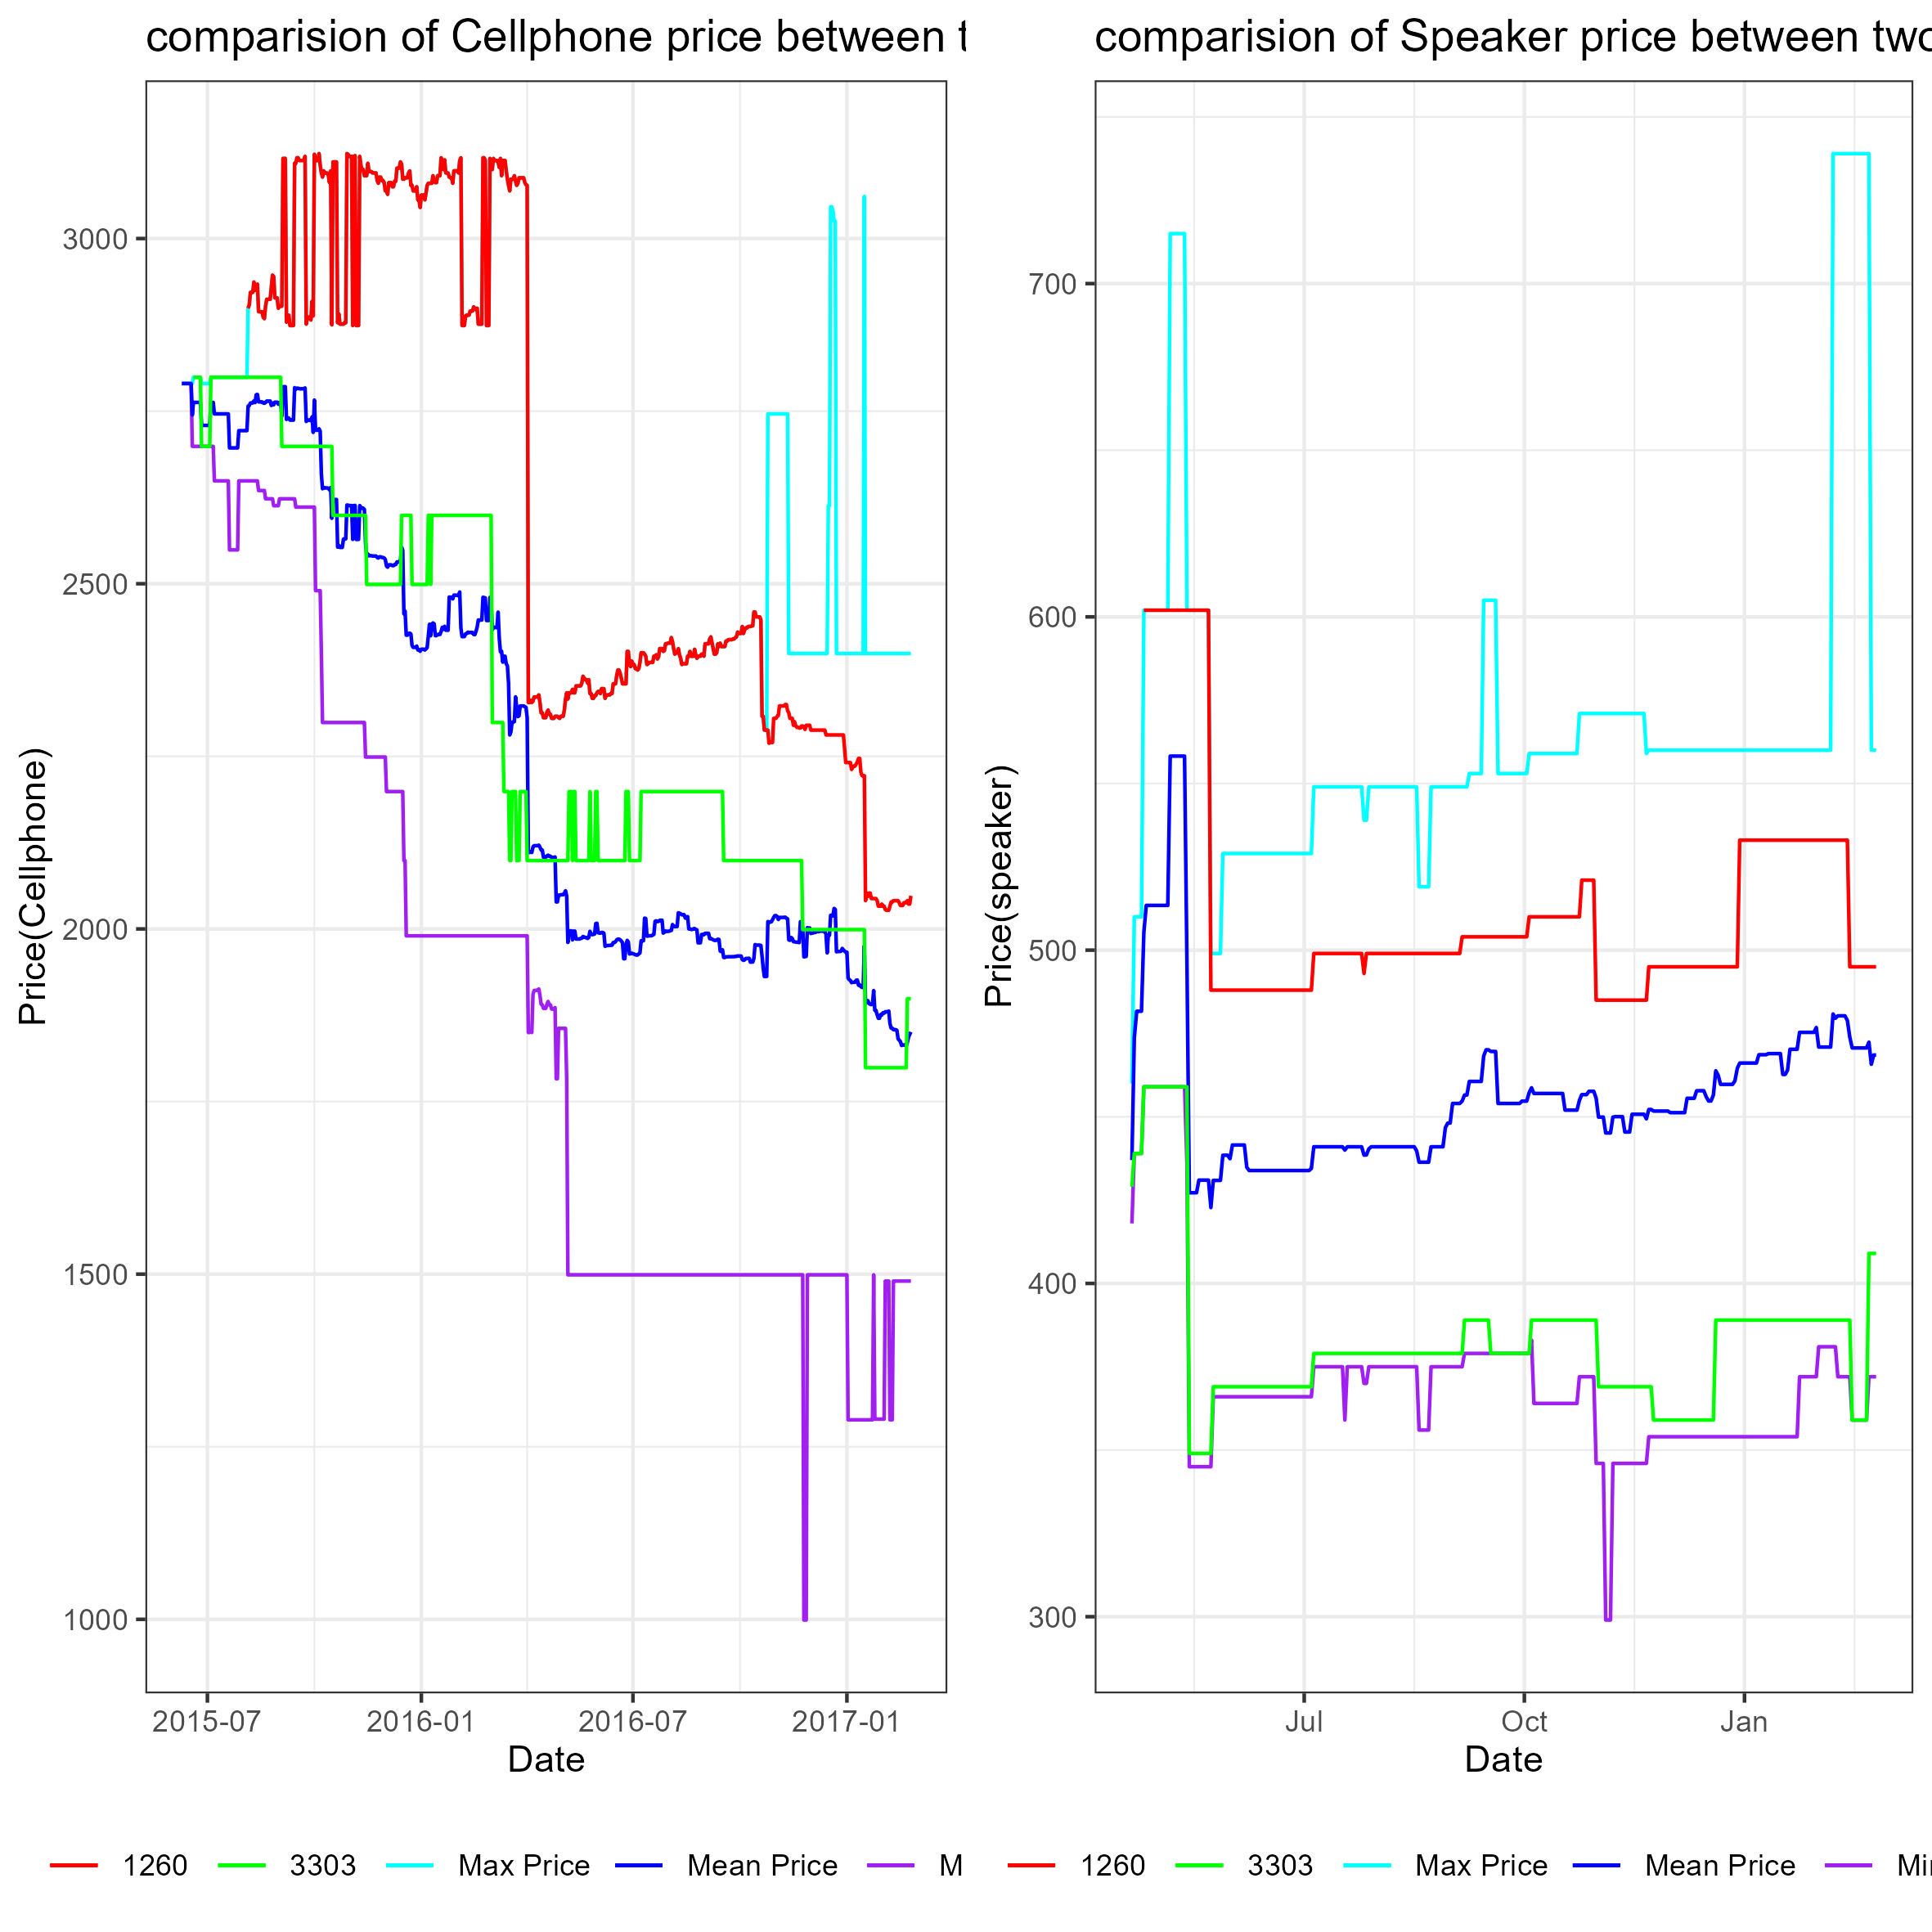
Result And Discussion
Selected store Price vs population Max, Min, Mean, and prices
Both graphs indicate both products in store 1260 is above the mean
Store 3303’s cellphone price is close to the Mean price
Speaker price of the store 3303 close to the minimum price
Store 3303 used a “minimum price” strategy for placing their price for speaker products and near mean price for cellphone product
Store 1260 has placed their cellphone price near the max price for cellphone products and above the mean for speaker product
Notes:
Top graph indicate both store price ,population price,mean and sd prices
Second graph indicate max min mean with store price

Slide 8
conclusion
Stores 1260 and 3303 stores had a similar downward trend for cell phones.
Store 1260 continuously sold cellphone and mobile speaker products at a higher price than store 3303.
The study also revealed that both stores had significantly dropped their prices between January 2016 and July 2016, possibly in response to a change in the economic ecosystem
“It can be said that these two stores have utilized opposing strategies during 2015 and 2017 while following the same pricing trend as that of the adjusted CPI. “

Slide 9

END

